Slide 1
INFO1112 Tutorial
Week 5

Slide 2

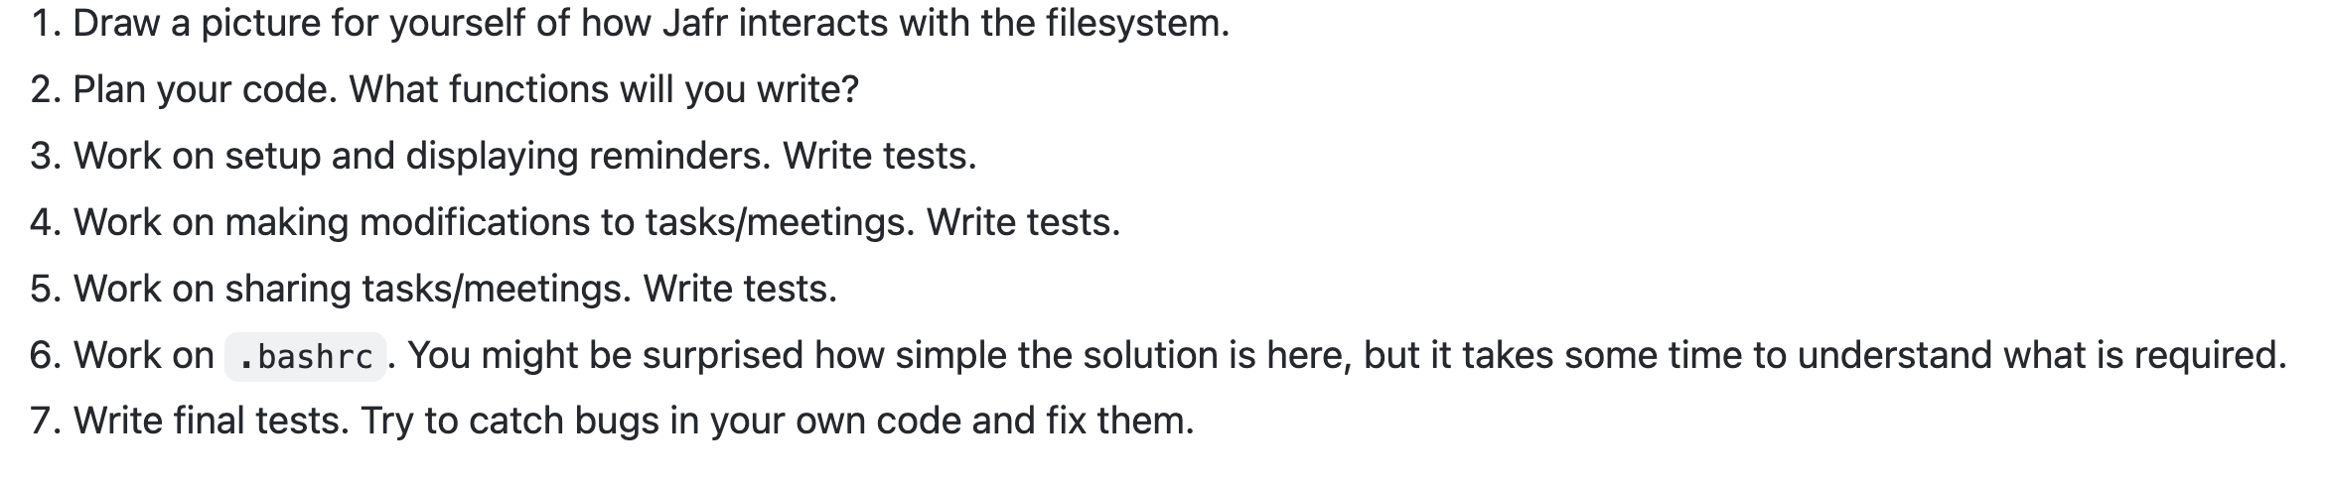
Assignment 1 Brief Info
Assignment 1 – due 3rd September (6 days)
Half of the students in this class have not started their assignment, please get to it
If you guys have any questions, make sure to read the specifications or ask Edstem
Make sure you have not used any Banned Functions
os.walk()
os.fwalk()
os.listdir()
Be sure to consult the order of how to start on the assignment specifications

Slide 3
Homework stuff
Homework 1
Marks have been released, please check to make sure you have been fairly marked
If you have any questions about marking please let me know
Homework 2 – interviews to be done today
Remember must complete interview to be eligible for maximum marks

Slide 4
Brief summary of this week’s content

Slide 5
5.1 – Emulators and Virtual Machines
CPU instructions
Take a binary form
00001001 0000011
Certain number of bits allocated for
instruction code (varies depending on CPU architecture)
arguments, usually a memory address (in RAM or a CPU register)
Each CPU architecture has its own way of understanding binary instructions

Slide 6
5.1 – Emulators and Virtual Machines
Assembly language
Human readable format which directly represents instructions CPU will execute
From previous slide’s example, the binary instruction 00000100 10001100 can be translated (in hypothetical assembly language) as:
LOAD 0x48,R12
Working with binary numbers
To extract certain information from instructions, bitwise operations are used

Slide 7
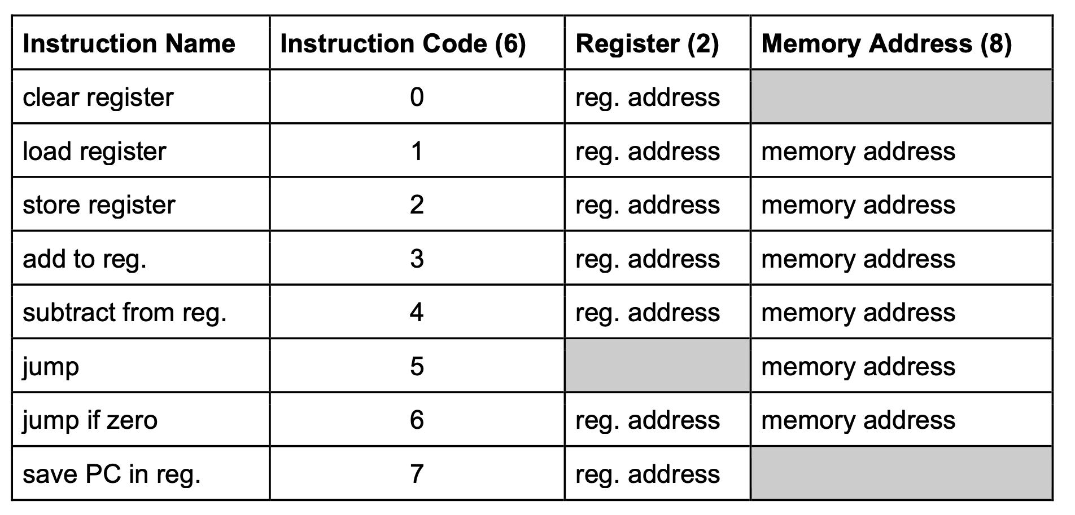
Build Assembly Code From Binary
Example instructions (Tutorial architecture):
000010 01 0000011
STORE 0x03, R1
000011 11 0000001
ADD 0x01, R3
000000 00 1001111
CLEAR R0

Slide 8
5.1 – Bitwise Operations
The AND operation (&) – for two aligned binary numbers, returns binary number where
if both bits = 1, corresponding bit in new binary number = 1
otherwise, corresponding bit in new binary number = 0
Example: 0b11010 & 0b01011 = 0b01010
AND operation often used as a bit mask – we make a binary number with the bits we want to get set to = 1, then all the other bits get ignored as a result
Bit shifting – shifts bits of a binary number left (<<) or right (>>)
Binary number retains number of digits it originally had
Extra info that has been shifted “out of frame” is discarded
Example: 0b1011101 >> 4 = 0b101
→ empty spaces filled with 0s: 00001011101 → discard bits out of frame: 0b0000101
 | 1 | 1 | 0 | 1 | 0
& | 0 | 1 | 0 | 1 | 1
 | 0 | 1 | 0 | 1 | 0

Slide 9
5.1 – Emulators and Virtual Machines
Emulators – programs which can run code designed for a different CPU/system architecture, and translate it to run on our own system
Name of “emulate” – effectively simulates a completely different system
Emulators will take CPU instructions given by a program for a specific system hardware (e.g. x86), and translate it to system instructions for another hardware type (e.g. ARM)
Often used to
emulate older system architecture to run programs (e.g. Commodore 64, PowerPC)
emulate a game console to play console games on a computer
Virtual machines – program which gains limited access to real hardware resources and constructs a virtual computer based on this hardware
Does not emulate system code – so “virtual” system must have same architecture as host computer (so that the same CPU instructions are used)
Can choose how much hardware resources to allocate to virtual system
Often faster than emulators, as instructions do not have to be translated

Slide 10
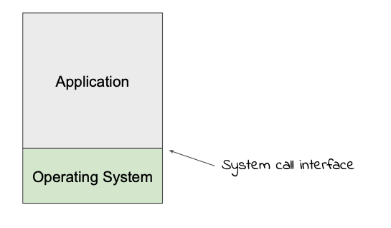
5.2 – Containers
Before talking about containers, it is important to talk about a computer application’s environment
In general, the running environment of a computer is separated into:
application environment and its own memory
operating system
If the application wants to access other resources, e.g. files, devices, other things in the namespace, etc., it must perform a system call
System call interface allows for communication between application and OS
Motive: if we can capture the system calls from a running application, we can “trick” the application into working in a different environment

Slide 11
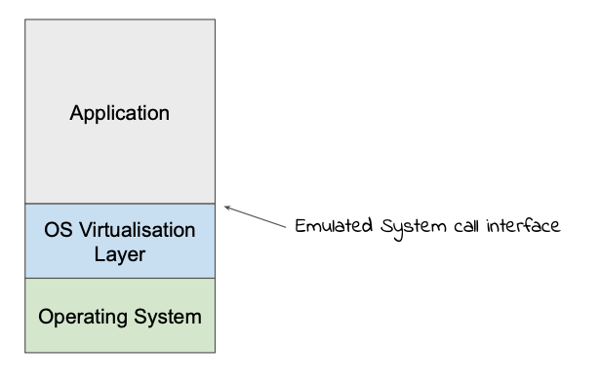
5.2 – Containers
Containers are programs which provide a virtualised namespace for applications to access with an emulated system call interface
Applications think they are running in a completely different environment, or even OS
Because containers only emulate system call interface, applications can access real hardware
more lightweight than virtual machine
Virtualised namespaces often contain common utilities found on a regular OS:
standard command-line programs
configuration files
libraries

Slide 12

Attendance
https://bit.ly/3QtnFKi

Slide 13
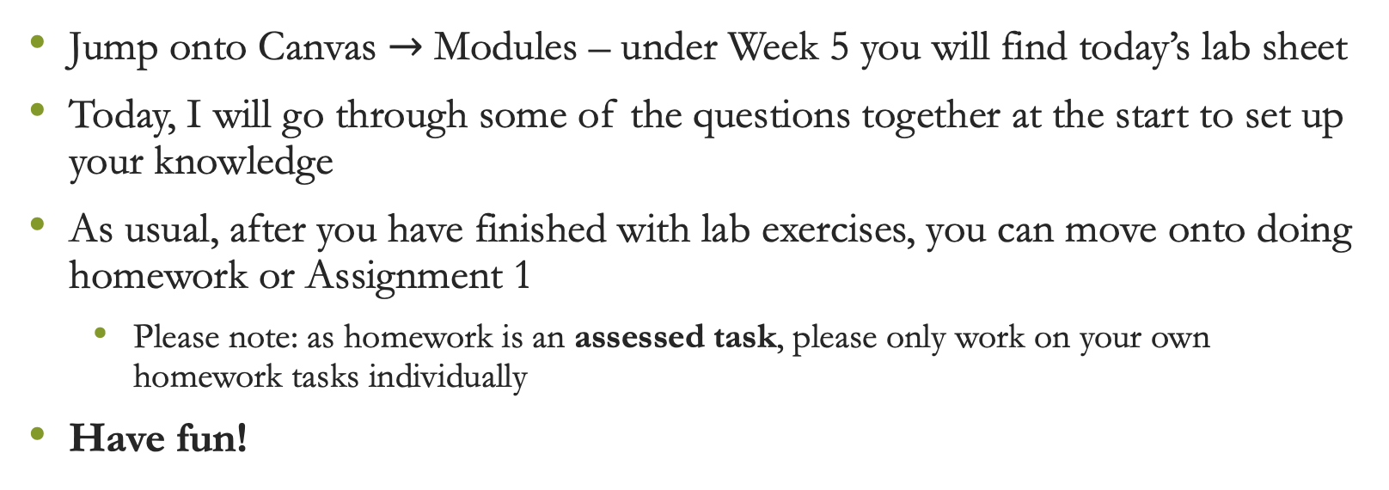
Lab exercises
Jump onto Canvas $→$ Modules – under Week 5 you will find today’s lab sheet
Today, I will go through some of the questions together at the start to set up your knowledge
As usual, after you have finished with lab exercises, you can move onto doing homework or Assignment 1
Please note: as homework is an assessed task, please only work on your own homework tasks individually
Have fun!

